Slide 1
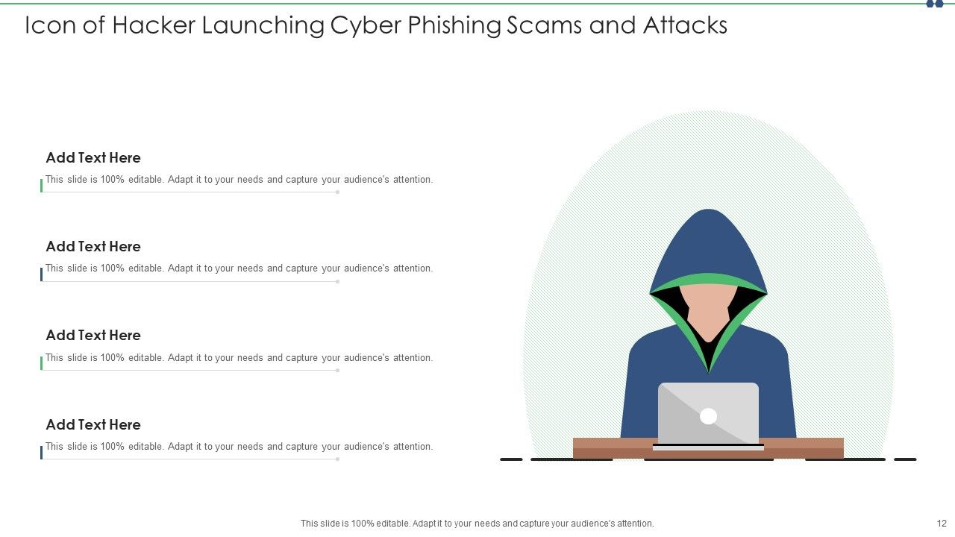
PHISHING ATTACKS.
Think before you click!
Presented by – Arpita Shikhare

Slide 2
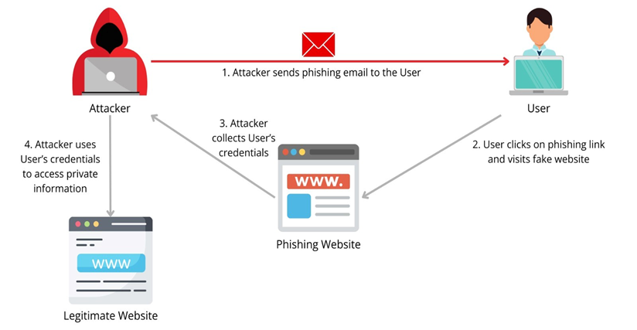
WHAT IS PHISHING?
Phishing is the act of pretending to be someone, or something, to get information not usually available.
People can be gullible and curious & click on things they shouldn’t – often a link will direct to a fake login page in an attempt to steal credentials.

Slide 3
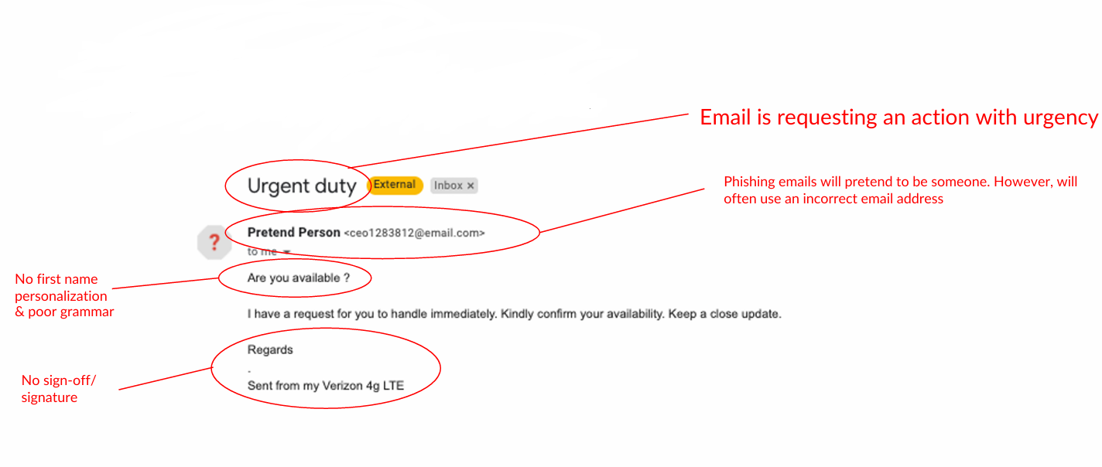
LEARN TO SPOT PHISHING EMAILS

Slide 4
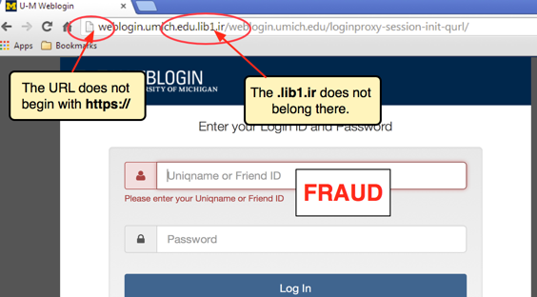
LEARN TO SPOT FAKE WESITES
Legitimate Site | Phishing site
HTTPS 🔒 | No lock ❌
Correct URL | Misspelled URL
Trusted | Fake login page

Slide 5
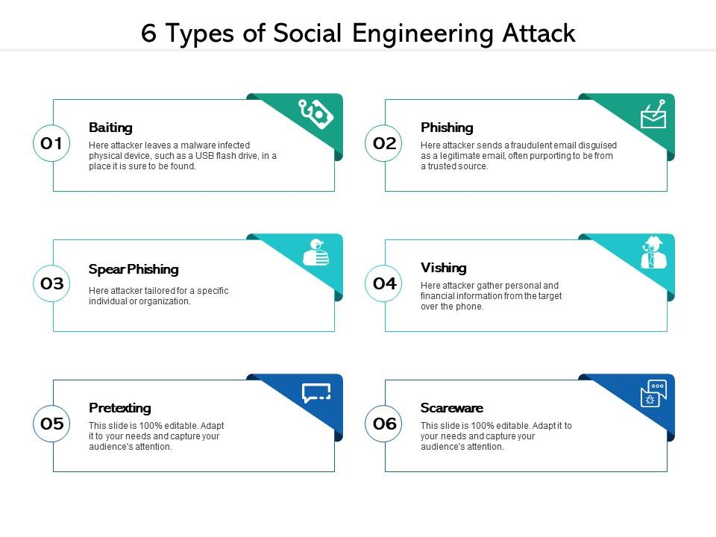
SOCIAL ENGINEERING TACTICS USED BY ATTACKERS

Slide 6
PRACTICES TO STAY SAFE
Verify the sender's identity before opening emails or messages.
Do not click suspicious links or download unknown attachments.
Check website URLs carefully for spelling mistakes or fake domains.
Never share passwords, OTPs, or personal information through email or messages.
Enable Multi-Factor Authentication (MFA/2FA) for added security.
Keep software and antivirus updated to protect against threats.
Be cautious of urgent or threatening messages that pressure immediate action.
Report phishing emails to your organization or email provider.

Slide 7
REAL-WORLD EXAMPLES OF PHISHING ATTACKS
Students receive emails promising scholarships but asking for personal information or login credentials.
An email claiming your bank account is locked asks you to click a link and verify your credentials.
A fake delivery message says your package is delayed and requests payment details.
🎯 Interactive Quiz
You receive an email saying: "Your bank account will be suspended within 24 hours. Click here and enter your login credentials to keep your account active."
What is the biggest warning sign?
The email uses your name
The message creates urgency and asks for credentials
The email contains a bank logo
The email is about your account

